Slide 1
History of Gaming
Martynas Kuliešius IFF-1/9

Slide 2
AGENDA
What is gaming and why we need it?
First ever video game
Evolution of Input devices
​Esports
Most popular game genres
Historical Gaming Flops
​Summary​

Slide 3
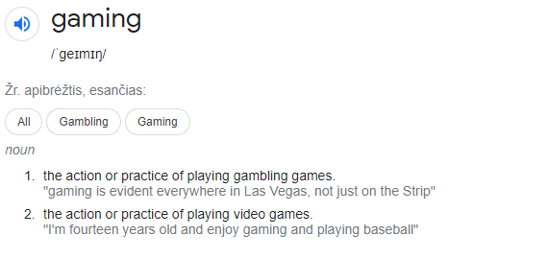
What is gaming?

Slide 4
Why do we need gaming?
Increased hand-to-eye coordination
Faster and more accurate decision-making
Better eyesight (attention to detail)
Improved problem-solving skills and logic
Improved cognitive abilities
Possibility to make money

Slide 5
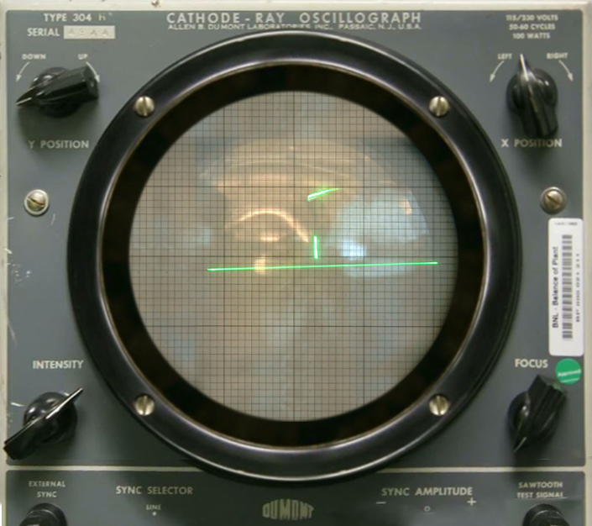

First video Game
1958 October William Higinbotham - “Tennis for Two”

Slide 6


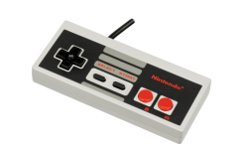
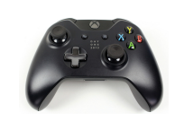



Evolution of Input devices

Slide 7
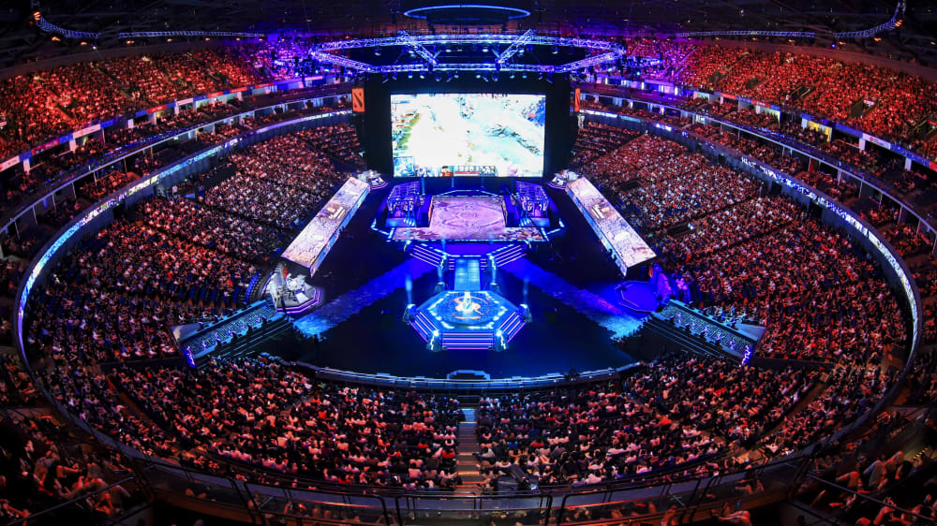
Esports
Form of competition using multiplayer video games
Not considered as a real sport, rather a mind sport like chess, shogi or poker
Arround 500 million viewers

Slide 8
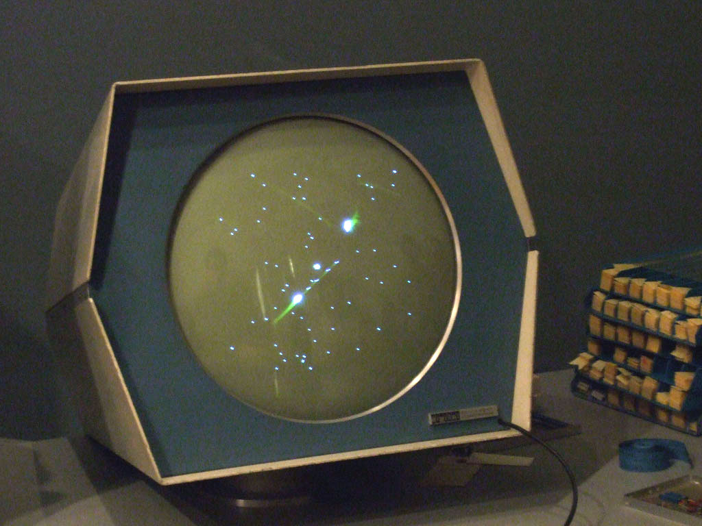
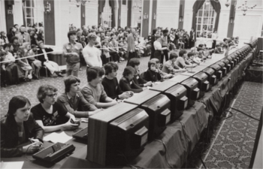
First esport tournament
Held in 1972 October 19th At Stanford University for the game Spacewar!

Slide 9
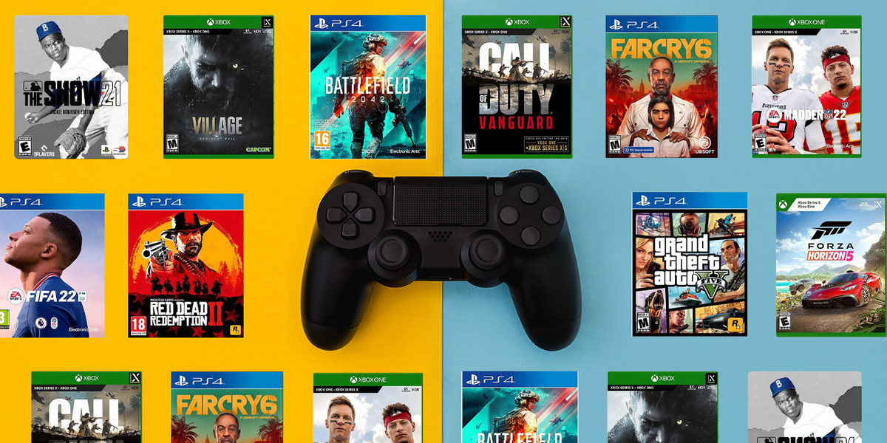
Most popular video game genres

Slide 10
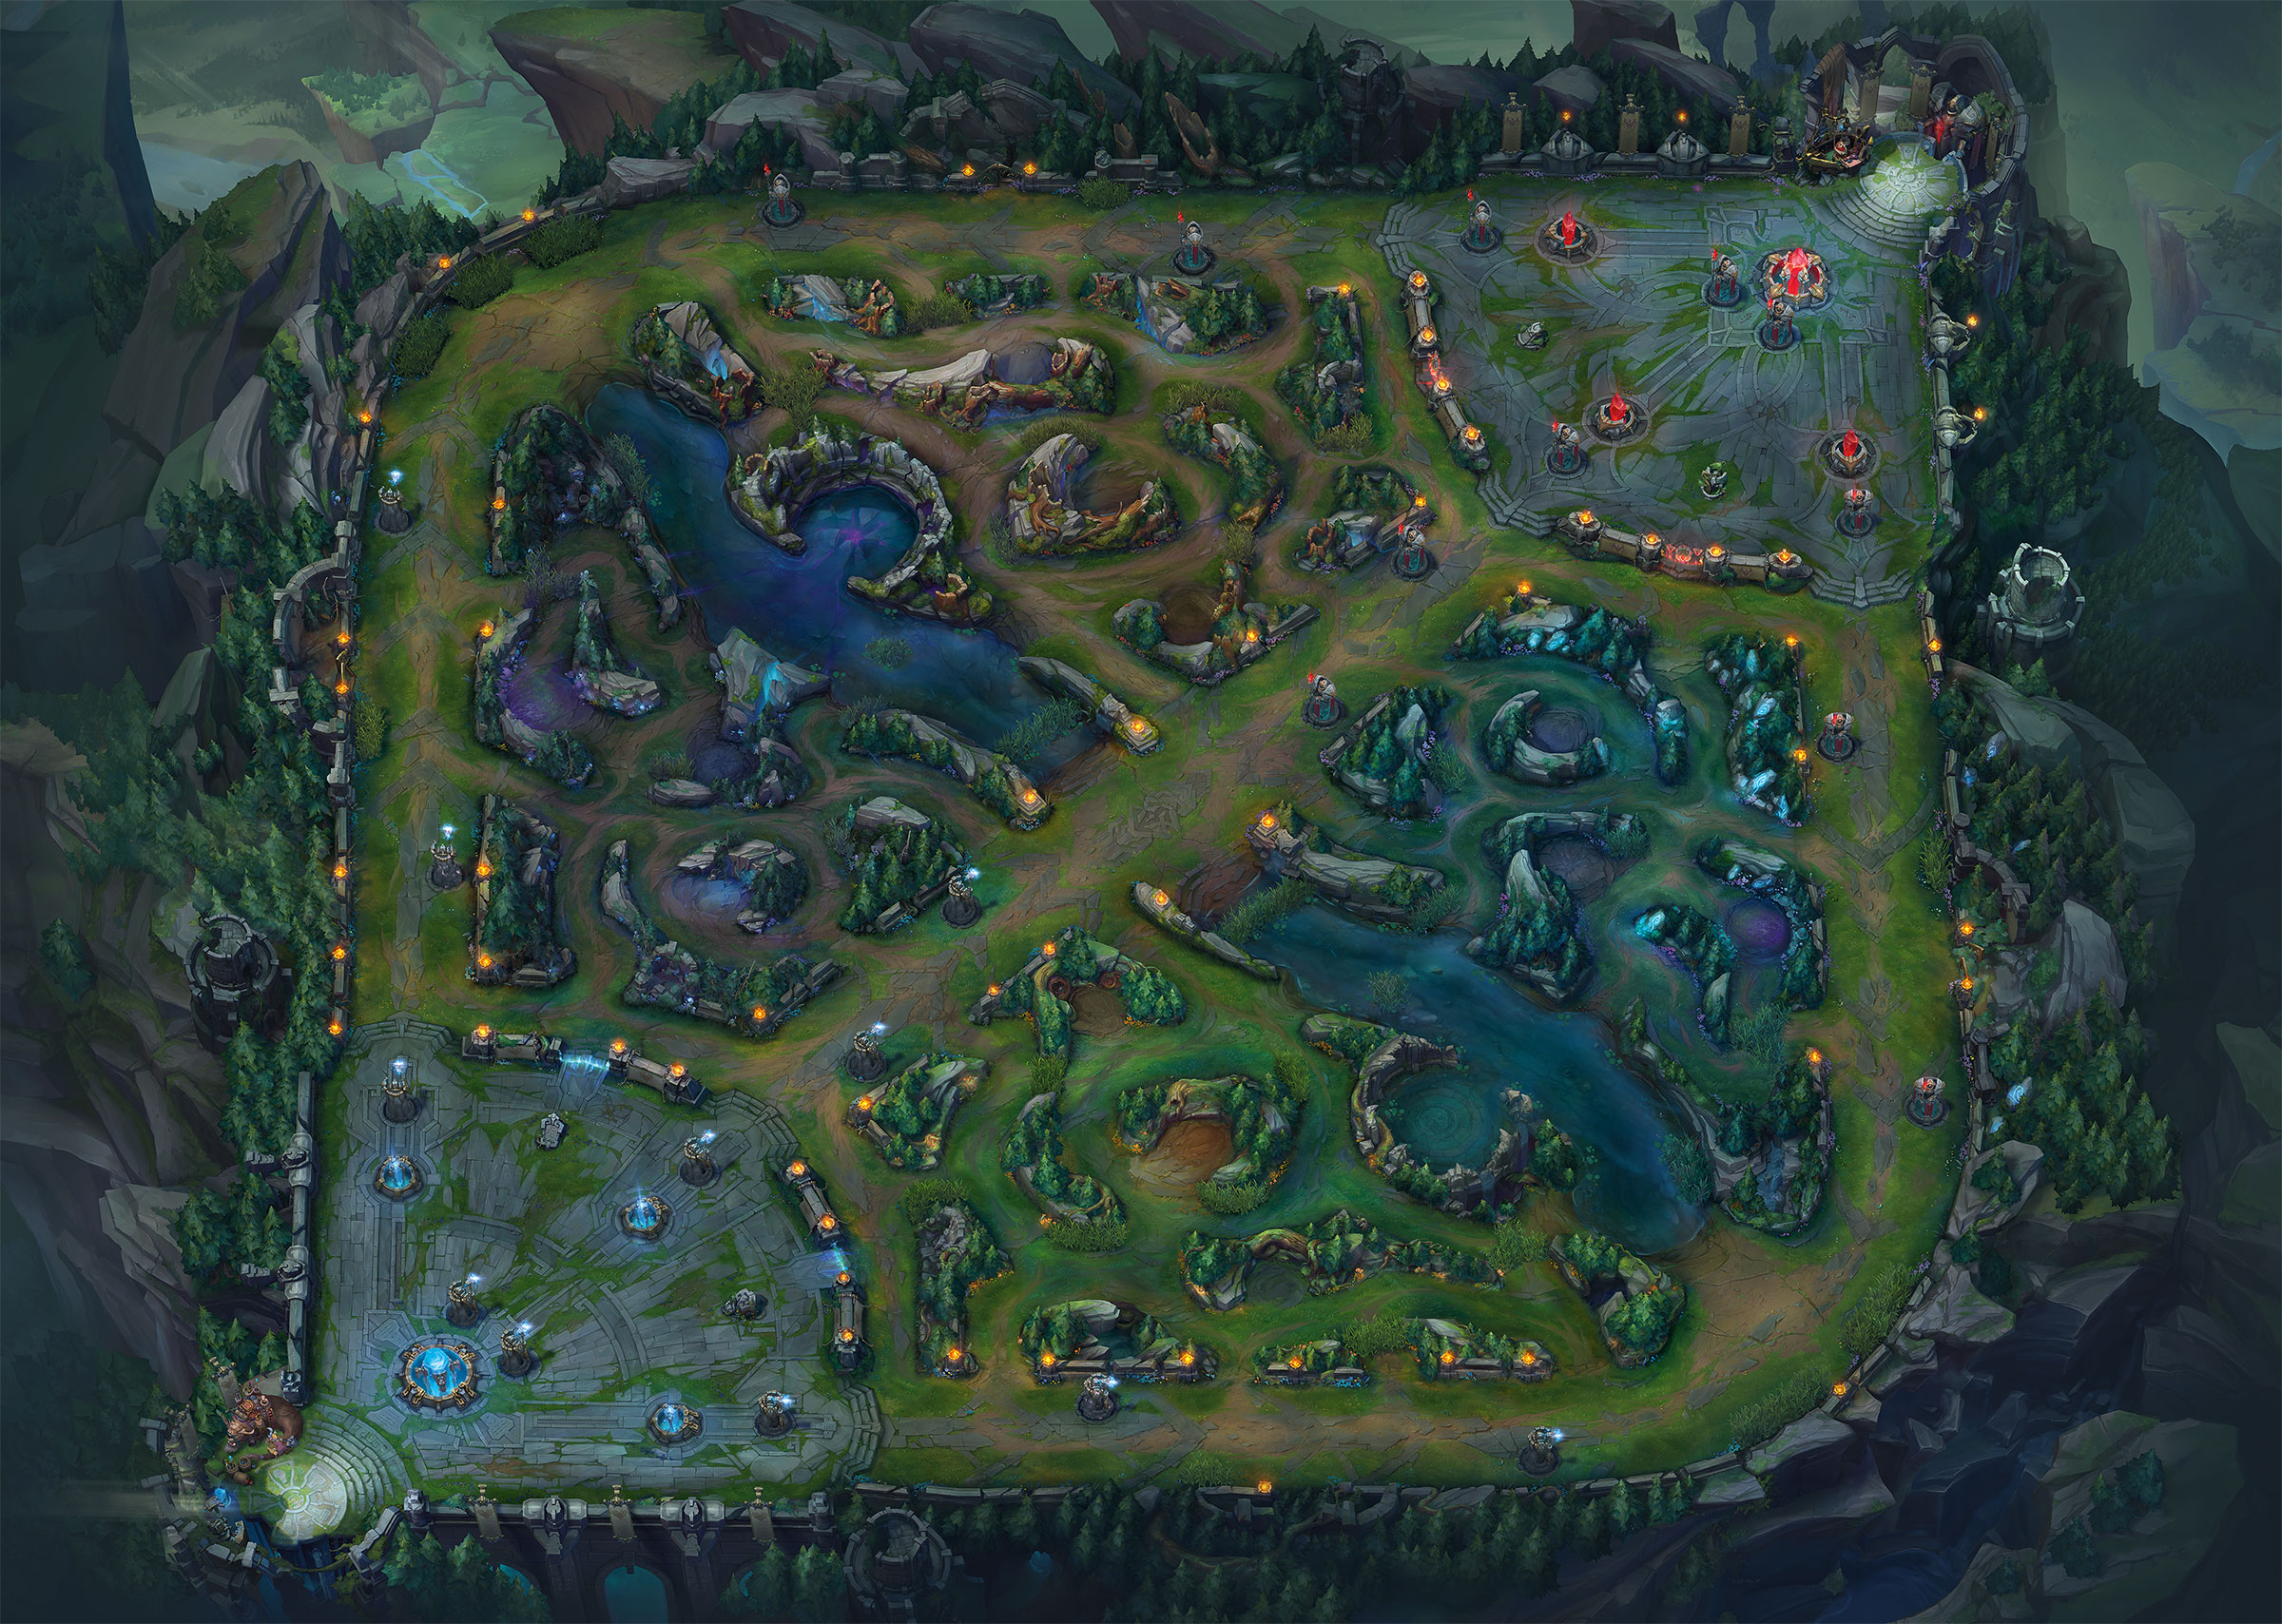
MOBA
Multiplayer online battle arena

Slide 11
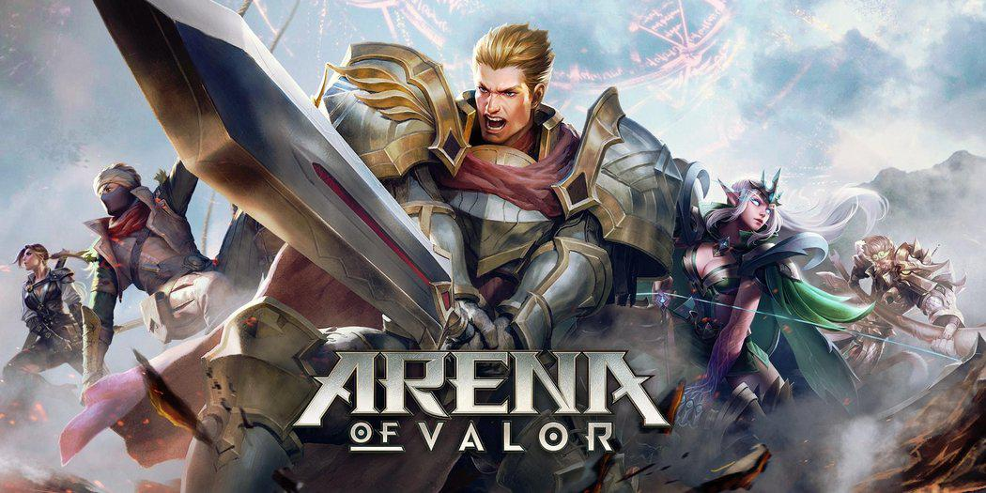
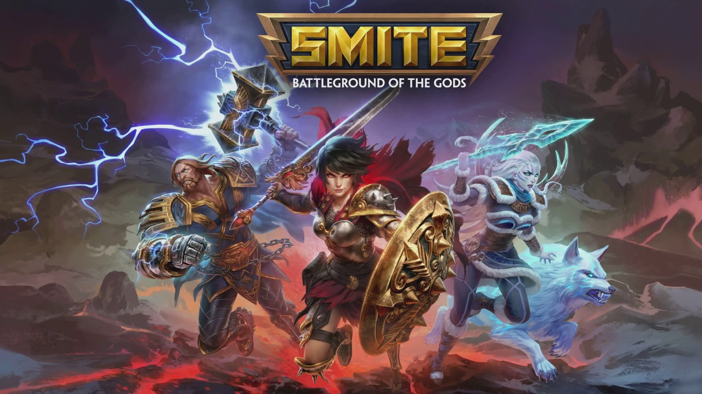

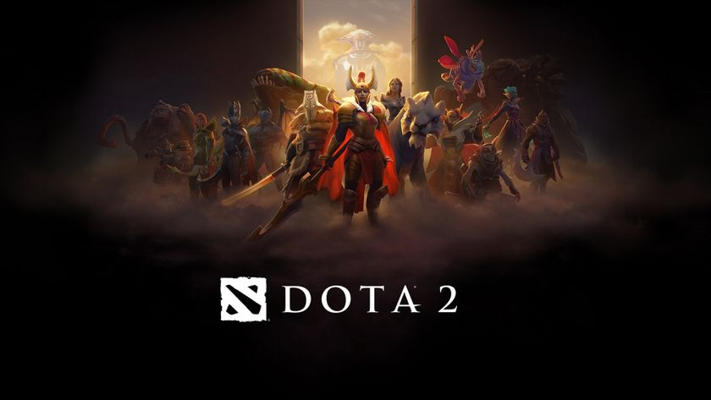
Most popular moba games:

Slide 12
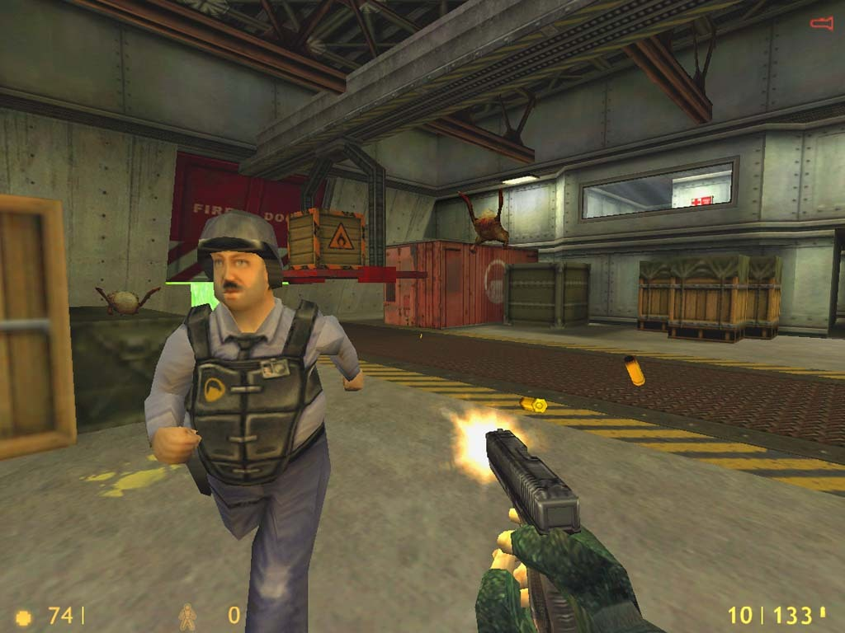
FPS
First-Person shooter

Slide 13



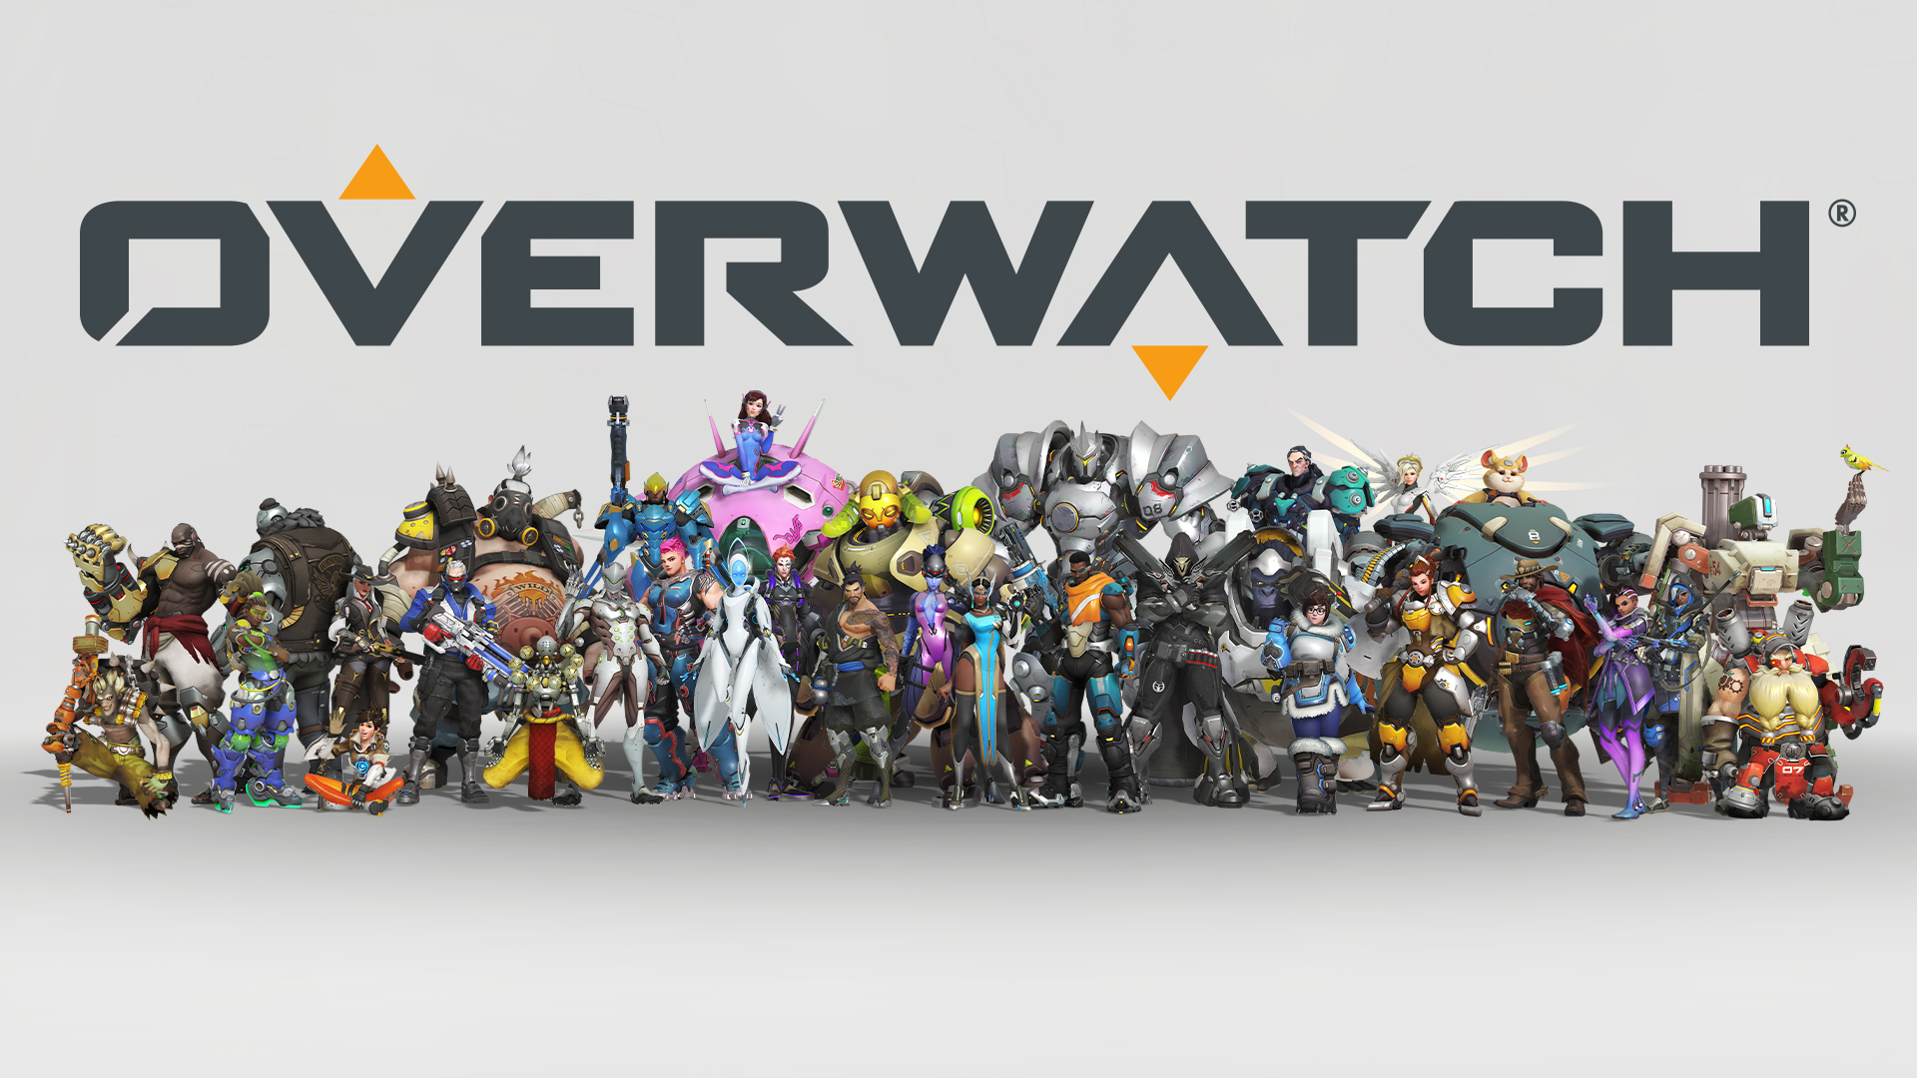
Most popular FPS games:

Slide 14
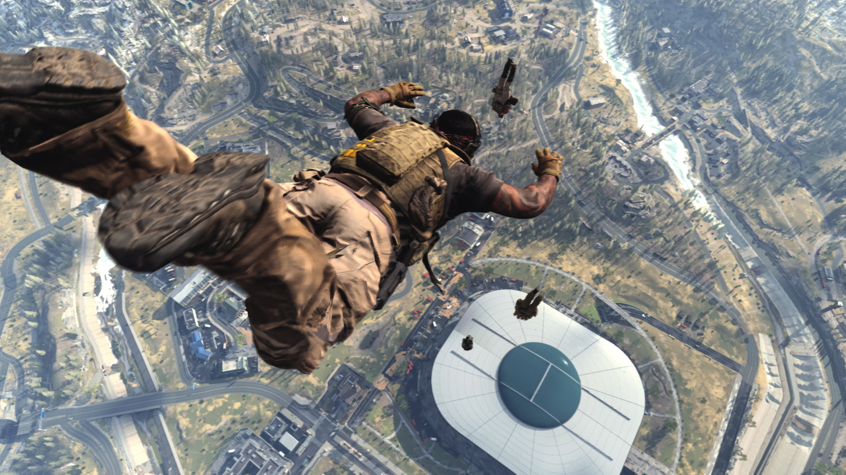
BR
Battle Royale

Slide 15
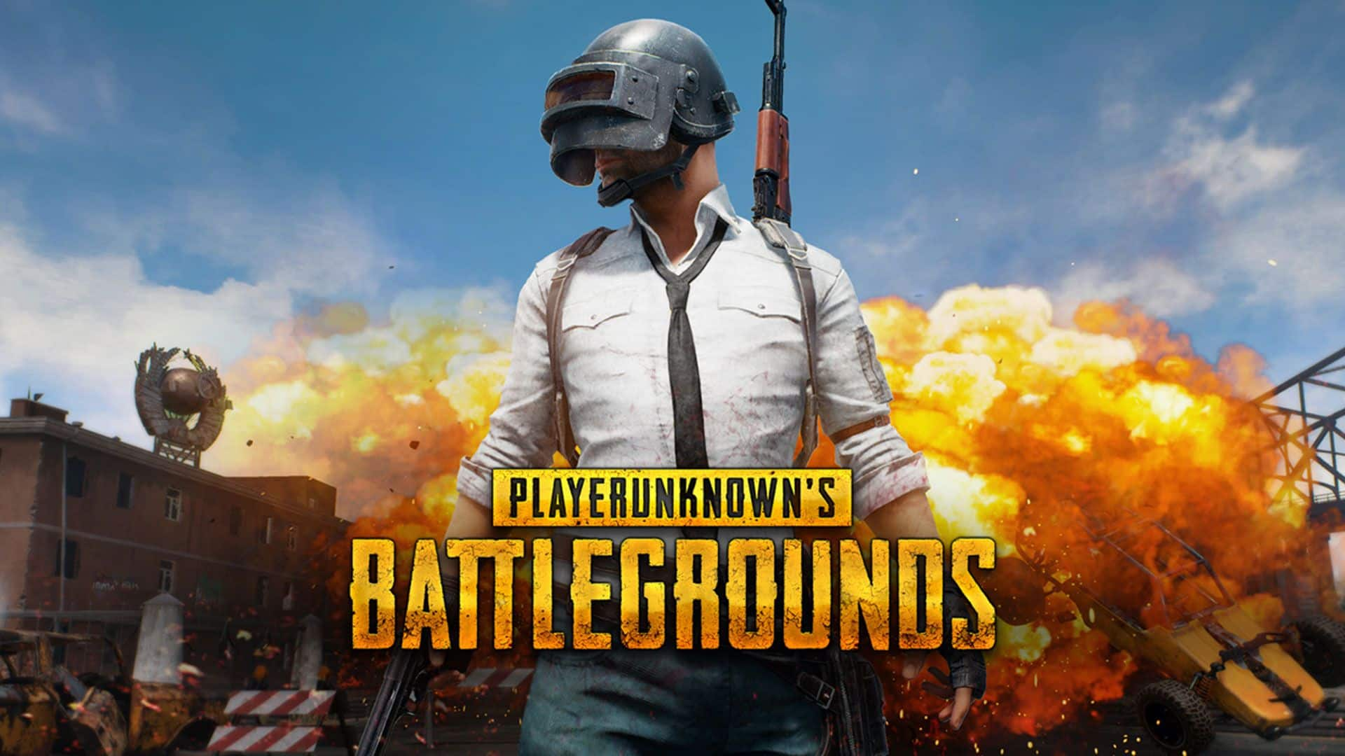
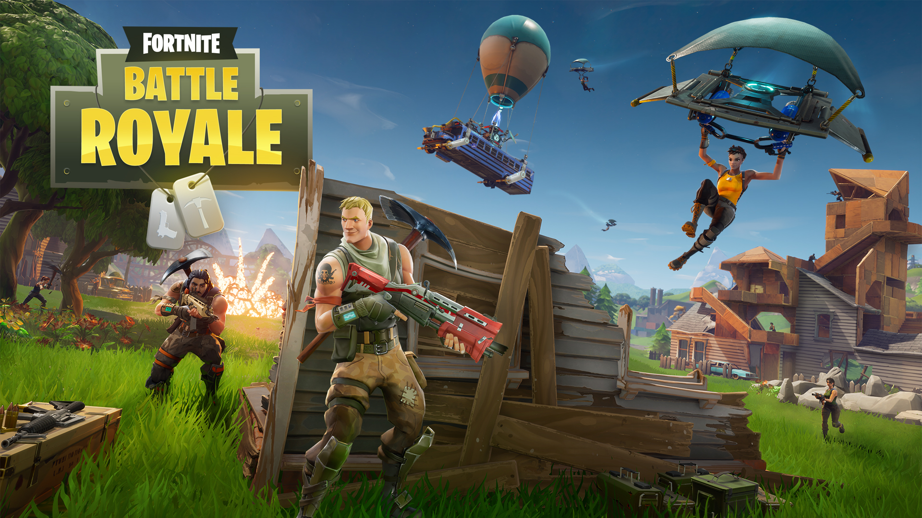

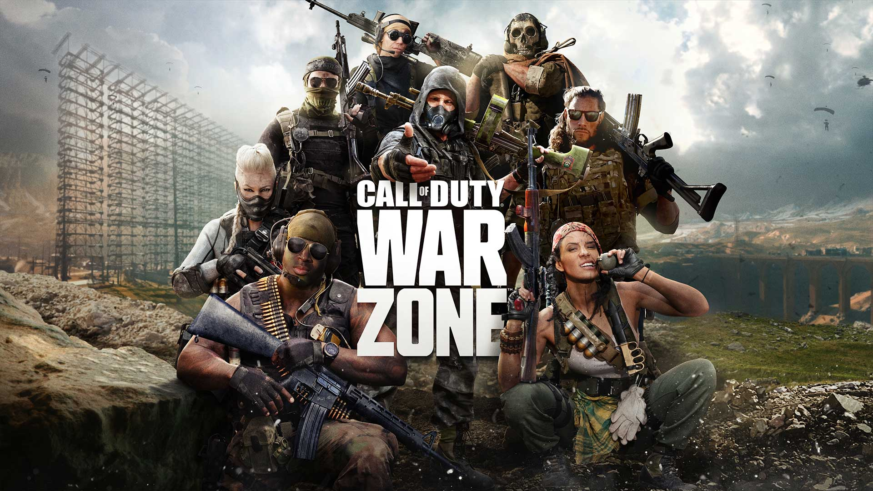
Most popular Battle Royale games:

Slide 16
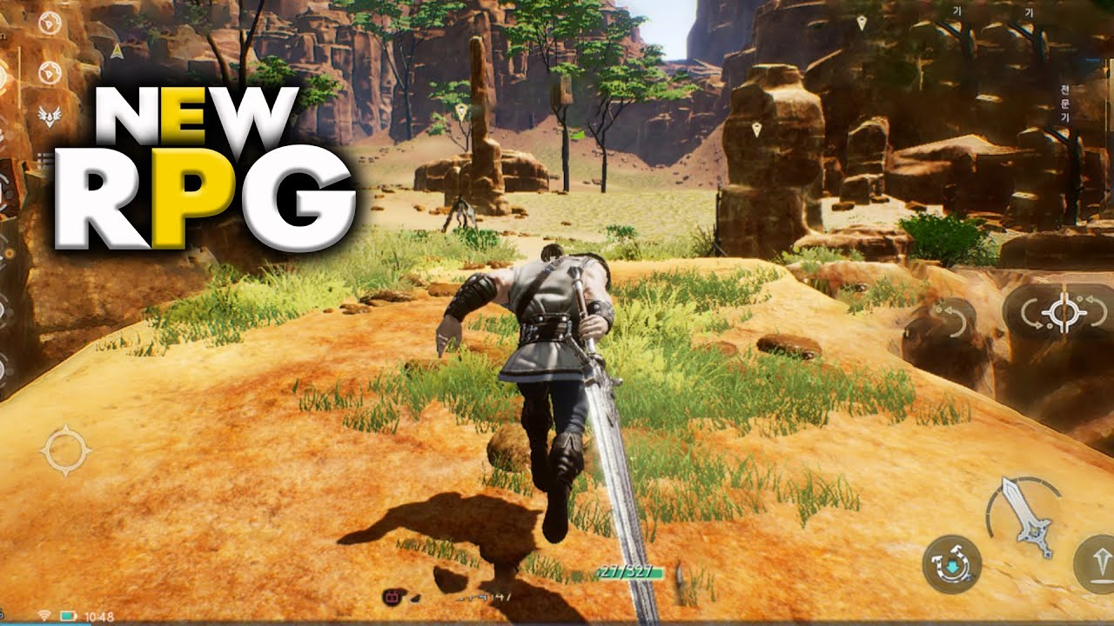

RPG
Role playing game
This
Not this

Slide 17

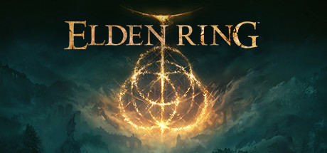


Most popular RPG games

Slide 18
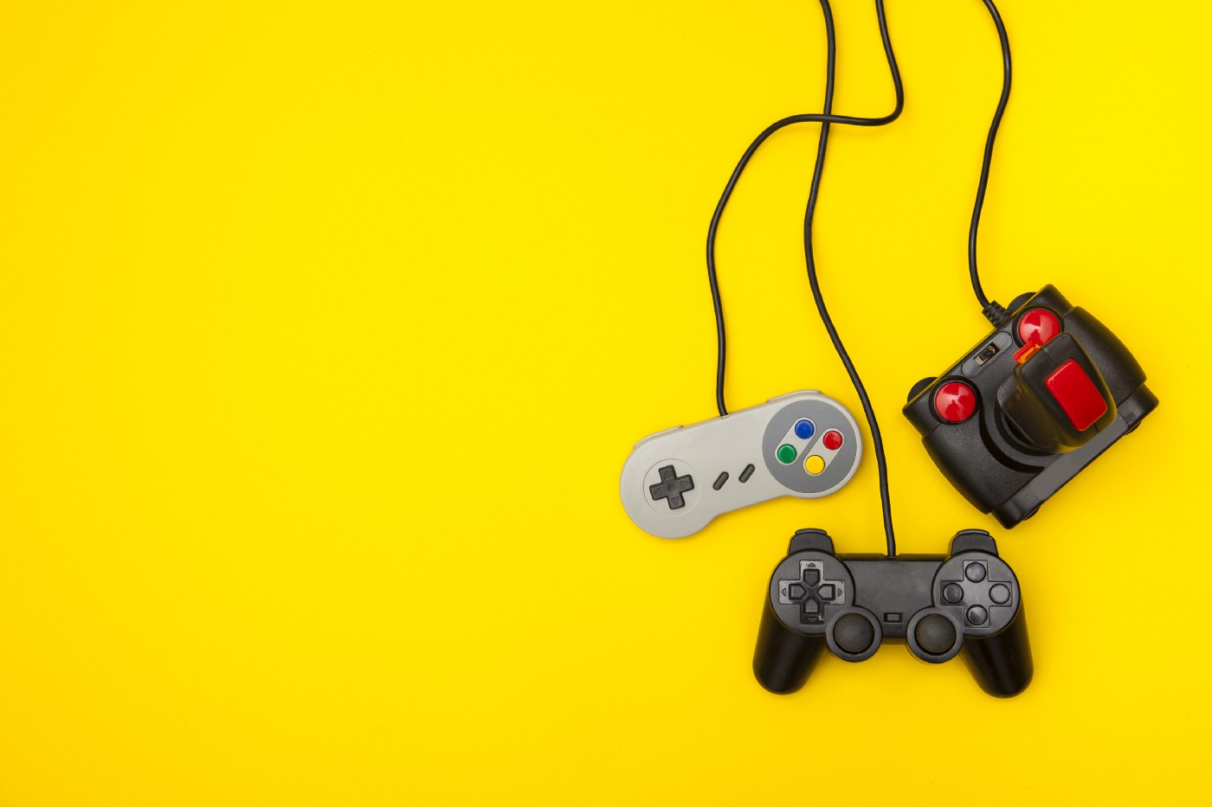
Historical gaming flops

Slide 19

1. ET: the extra-terrestrial
Reasons:
Millions of copies unsold
Game is and was considered the worst game ever
What happened:
Atari lost millions of dollars
Atari got sold to another company

Slide 20

2. Def Jam Rapstar
Reasons:
Poor sales
Unlicensed songs
What happened:
4mm game studio got sued by EMI for 8 million dollars
Konami and Autumn games got sued by City National Bank for credit fraud and 4mm closed down.

Slide 21

3. Cyberpunk 2077
Reasons:
Delayed release
Unfinished product
What happened:
CDPR stocks dropped 50%
Class action lawsuits happened

Slide 22
SUMMARY/Conclusion
Games are fun
Games help develop people
Games can earn you money

Slide 23
THANK YOU

Slide 24
Sources:
Trust me bro
https://www.workandmoney.com/s/biggest-video-game-flops-5ca3bdbee02141c8
https://en.wikipedia.org/wiki/Esports
https://www.thegamer.com/iconic-funny-video-game-memes/
https://www.tandfonline.com/doi/abs/10.1080/00933104.2016.1208596 - paywall
https://en.wikipedia.org/wiki/Atari
https://lt.wikipedia.org/wiki/CD_Projekt
https://gamequitters.com/positive-effects-of-video-games/
https://www.techtarget.com/whatis/definition/gaming
https://files.eric.ed.gov/fulltext/EJ1143830.pdf – read through all
https://www.aps.org/publications/apsnews/200810/physicshistory.cfm – read through all
https://www.tandfonline.com/doi/pdf/10.1080/13642529.2014.973714?needAccess=true – read through all
https://eric.ed.gov/?id=ED137165 – read through all
https://air.unimi.it/bitstream/2434/685287/2/Maggiorini2019_Chapter_EvolutionOfGameControllersTowa.pdf - read through all

